Slide 1
CSCE 1035 Computer Programming I Chapter 12 Files
University of North Texas

Slide 2

File I/O
Until now, the Python programs you’ve been writing are pretty simple for input and output
Type input at the keyboard
Results (output) are displayed in the terminal
This is acceptable for short and simple input
But what if we want to enter 50 numbers and mess up on the 37th?
Do we start all over?
One solution is to read the information from a file
You could even write information to a file
This process is called File I/O
"I/O" stands for "input/output"
Python has built-in functions that make this easy

Slide 3

12.1 Reading Files

Slide 4
Python File Handling Operations
There are four essential types of operations that can be handled by Python on files
Open the file
Read from the file
Write to the file
Close the file
Other operations include
Rename the file
os.rename("test.txt", "test1.txt")
Delete the file
os.remove(filename)

Slide 5
Opening Files
Before we can work with a file, we need to associate the file variable with the physical file using the open() built-in function
file_object = open(filename [, mode], [buffering])
Opens the file and returns a file object that will be used for further operations on that file
It also positions the file pointer at the start of the file
filename is a required string that contains the name of the file you want to access
mode is an optional string specifying the access mode (read, write, append, etc.) in which the file will be opened
buffering is an optional integer that specifies the desired buffer size for the file

Slide 6
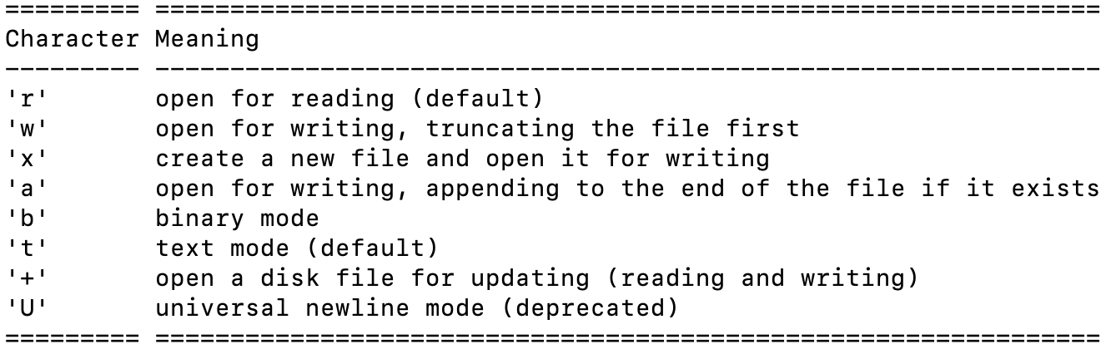
Opening Files
The access modes for opening a file include
The desired buffer size includes
1 line buffered
0 unbuffered
any other positive value a buffer of that size in bytes
any negative value use system default, which is usually line buffered (default)

Slide 7
Closing Files
Although a file is automatically closed when your program ends, it is good practice to close your file as soon as the program is done with it
If your program encounters a runtime error and crashes before it reaches the end, the file may remain "locked" in an inaccessible state because it is still open
file_object.close()
The close() method flushes any unwritten information and closes the file object, after which no more writing can be done
The file object contains several attributes related to that file
.closed returns True if file is closed, False otherwise
.mode returns access mode with which file was opened
.name returns name of file

Slide 8
File Exception Handling
An IOError exception is raised when an I/O operation fails for an I/O-related reason
I/O operations include print() statements, the built-in open() function, and methods on a file object
try:
in_file = open('input_file.txt', 'r')
… # file operations
except IOError as errmsg:
print('IOError:', errmsg)

Slide 9
Reading Files
There are three common ways to read files
file_object.read([n])
Reads the file’s entire contents as a string
file_object.readline([n])
Reads the next line from the file as a string
file_object.readlines([n])
Reads the file’s entire contents as a list of lines
The lines from a file object can also be read using a for loop
for line in file_object:
print(line)
Each execution of the loop will read a line from the file into a string
Each method reads at most n bytes/characters if specified

Slide 10
12.2 Writing Files

Slide 11
Writing to Files
In order to write to a file in Python, it needs to be opened in write ('w'), append ('a'), or creation ('x') mode
You can also add a '+' character to the end of a mode to specify update mode, which allows for both reading and writing of a file at the same time
Using 'w' mode will overwrite the file if it already exists
There are two common ways to write data to a file
file_object.write(string)
The write() method does not add a newline character ('\n') to the end of the string
file_object.writelines(list)
Writes a list of strings, one at a time, to the file
If the list contains non-string elements, you must cast it as a str()

Slide 12
Buffered Output
When we work with files, a buffer is automatically associated with the file when it is opened
A buffer is an area in memory where data is temporarily stored before being written to the file
>>> import io
>>> io.DEFAULT_BUFFER_SIZE
8192
When writing content to the file, first it goes to the buffer, and once the buffer is full, data is written to the file
The flush() method can be used to force the transfer of data from the buffer to the file
When a file is closed, any unsaved data is transferred to the file

Slide 13
12.3 Interacting with File Systems

Slide 14
Environment Variables
The os module allows interaction with the Operating System, either generically or specific to a particular OS
This includes environment variable manipulation and file system navigation
os.environ is a mapping object containing environment information
import os
print(os.environ['PATH'])
print(os.environ['HOME'])
For more information on setting environment variables
https://docs.python.org/3/library/os.html#os.environ

Slide 15
Program Portability
Portability across different operating systems is important to avoid scenarios where the program works correctly in one computer, but crashes in another
Especially when reading and writing files outside of the executing program’s directory since the path separator may be different
>>> os.path.sep
'/'
Rather than hardcoding the path separator in the path, you can concatenate one or more path components using
os.path.join(path, *args)
where path is a path-like object (a string or bytes object) representing a file system path, and *args is a variable number of path-like arguments
Returns a string that represents concatenated path components

Slide 16
Program Portability
You are able to get the directory and filename for a path using
os.path.split(path)
This method splits a full pathname and returns a tuple containing the path and filename
You can split a filename using
os.path.splitext(filename)
This method returns a tuple containing the filename and the file extension
>>> import os
>>> os.path.splitext('file1.txt')
('file1', '.txt')

Slide 17
Directory Functions
os.getcwd()
Returns a string representing the current working directory
os.chdir(path)
Change the current working directory to the specified path
os.listdir(path=None)
Returns a list containing names of files in the directory
If path is None, uses the path='.'
os.mkdir(path)
Creates a directory
You can also run the mkdir command in the system shell using
os.system('mkdir new_directory’)
os.path.exists(filename)
Returns True if file with filename exists, False otherwise

Slide 18
OS Walk
The os.walk is a directory tree generator for getting a whole directory structure and files
os.walk(top[, topdown=True[, onerror=None[,
followlinks=False]]])
where
top is the required root folder that yields a 3-tuple [dirpath, dirnames, filenames]
topdown is the optional Boolean value to generate the directory top down if True; if False, directories are generated bottom up
onerror is the optional function to call with OSError parameter that can report the error to continue the walk or raise the exception to abort the walk
followlinks is the optional Boolean value to follow symbolic links to subdirectories if True (default False)

Slide 19
12.4 Binary Data

Slide 20
Binary Files
When files stored as sequence of bytes, known as binary data
E.g., JPEG images, audio or video clips, PDF files
Data in binary files cannot be directly read
Have to be read through a program (such as Python)
A byte object is an immutable object used to represent a sequence of single byte values, such as binary data read from a file
bytes([source[, encoding[, errors]]])
where
source is optional source to initialize the array of bytes
encoding is optional string encoding (e.g., 'ascii', 'utf-8')
errors is optional action to take when encoding conversion fails

Slide 21
Byte Literals
Byte literals can be written by prepending a 'b' prior to the opening quote
Can specify raw byte values in a string or bytes literal using the \x escape character preceding the hexadecimal value that describes the value of the byte
>>> code = b'Feliz Cumplea\xc3\xb1os'
>>> type(code)
<class 'bytes'>
>>> print(code)
b'Feliz Cumplea\xc3\xb1os'
>>> str1 = code.decode()
>>> type(str1)
<class 'str'>
>>> print(str1)
Feliz Cumpleaños
Can also use encode() string method to write as byte literal

Slide 22
Byte Literals
While using binary files, we have to use the modes with the letter 'b' at the end so that Python can understand that we are interacting with binary files
'wb' Open a file for write only mode in binary format
'rb' Open a file for the read-only mode in binary format
'ab' Open a file for appending only mode in binary format
'rb+' Open a file for read and write only mode in binary format
'ab+' Open a file for appending and read-only mode in binary format

Slide 23
Handling Binary Data
The struct module can be used in handling binary data
It uses format strings as compact descriptions of the layout of the structs and the intended conversion to/from Python values
It is also capable of composing and decomposing using endian-ness
'>' big-endian (most significant byte placed first in byte sequence)
E.g., integer 1 = 00 00 00 01
>>> (1).to_bytes(4, byteorder='big')
b'\x00\x00\x00\x01'
'<' little-endian (least significant byte placed first in byte sequence
E.g., integer 1 = 01 00 00 00
>>> (1).to_bytes(4, byteorder='little')
b'\x01\x00\x00\x00'

Slide 24
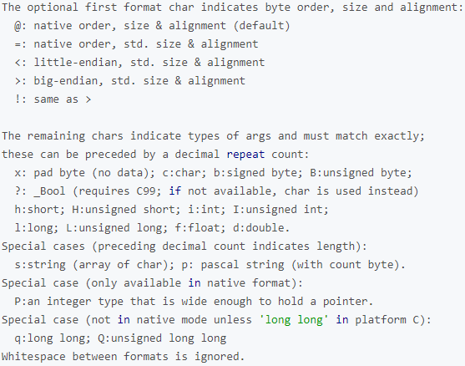
Format Strings Compact Descriptions
https://docs.python.org/3.6/library/struct.html#format-characters

Slide 25
Handling Binary Data
The struct.pack() method packs values such as strings and integers into a sequence of bytes
obj = struct.pack(format, v1, v2, …)
The struct.unpack() method unpacks the packed value into its original representation with the specified format
obj = struct.unpack(format, buffer)
>>> import struct
>>> list(b'Hello')
[72, 101, 108, 108, 111]
>>> packed = struct.pack(b'bbbbb', 72, 101, 108, 108, 111)
>>> print(packed)
b'Hello'
>>> struct.unpack(b'bbbbb', packed)
(72, 101, 108, 108, 111)
>>> struct.unpack(b'5s', packed)
(b'Hello',)
Always returns tuple with results, even if only unpacking single value

Slide 26
12.5 Command-Line Arguments with Files

Slide 27
Passing Files as Arguments
You can pass filenames as command-line arguments to a Python program
Before using, you will need to verify that the file exists
os.path.exists(filename)
Returns true if filename is a file, directory, or valid symlink
os.path.isfile(filename)
Returns true if filename is a regular file or symlink to a file

Slide 28
12.6 The 'with' Statement

Slide 29
Using the with Statement
Since open() and close() occur in pairs, Python provides a shortcut using the with statement
with open(filename) as variable:
# file operations
It simplifies exception handling by encapsulating both initial operations and closing or clean up tasks
We do not need a close() statement here since the with statement will automatically close the file
>>> with open('input2.txt') as f:
... f.readlines()
...
['1st line\n', '2nd line\n', '3rd line\n', '4th line\n']

Slide 30
12.7 Comma Separated Values Files

Slide 31
Reading CSV Files
A CSV (comma separated values) file allows data to be saved in a tabular structure with a .csv extension
The csv module has several functions and classes available for reading and writing CSVs
To pull data from a CSV file, you must use the reader() method on an already opened file to generate a reader object
The reader() method returns a reader object that iterates over lines of a CSV file
csv.reader(iterable[, dialect[, fmtparams]])
where each iteration returns a row of the CSV file, which can span multiple input lines
csv.DictReader maps information read into a dictionary, where first line of the file consists of dictionary keys

Slide 32
Writing CSV Files
The writer() method returns a writer object that writes data into a CSV file
To iterate over the rows, you may need to use the writerow() method
writerows() can directly write all rows at one time
csv.DictWriter is similar except that you are writing from a dictionary instead of a list
We must specify the column names in advance as part of our fieldnames
Then we need to write the first row (i.e., the header) using writeheader()

